Slide 1
Group M4
Michael C. Carlos Museum
Notes:
Please update the top two text boxes with which project you’re working on, your group number, and your group’s research question. You should also update the text underneath the “Progress” and “Obstacles” sections with your personalized content.

Slide 2
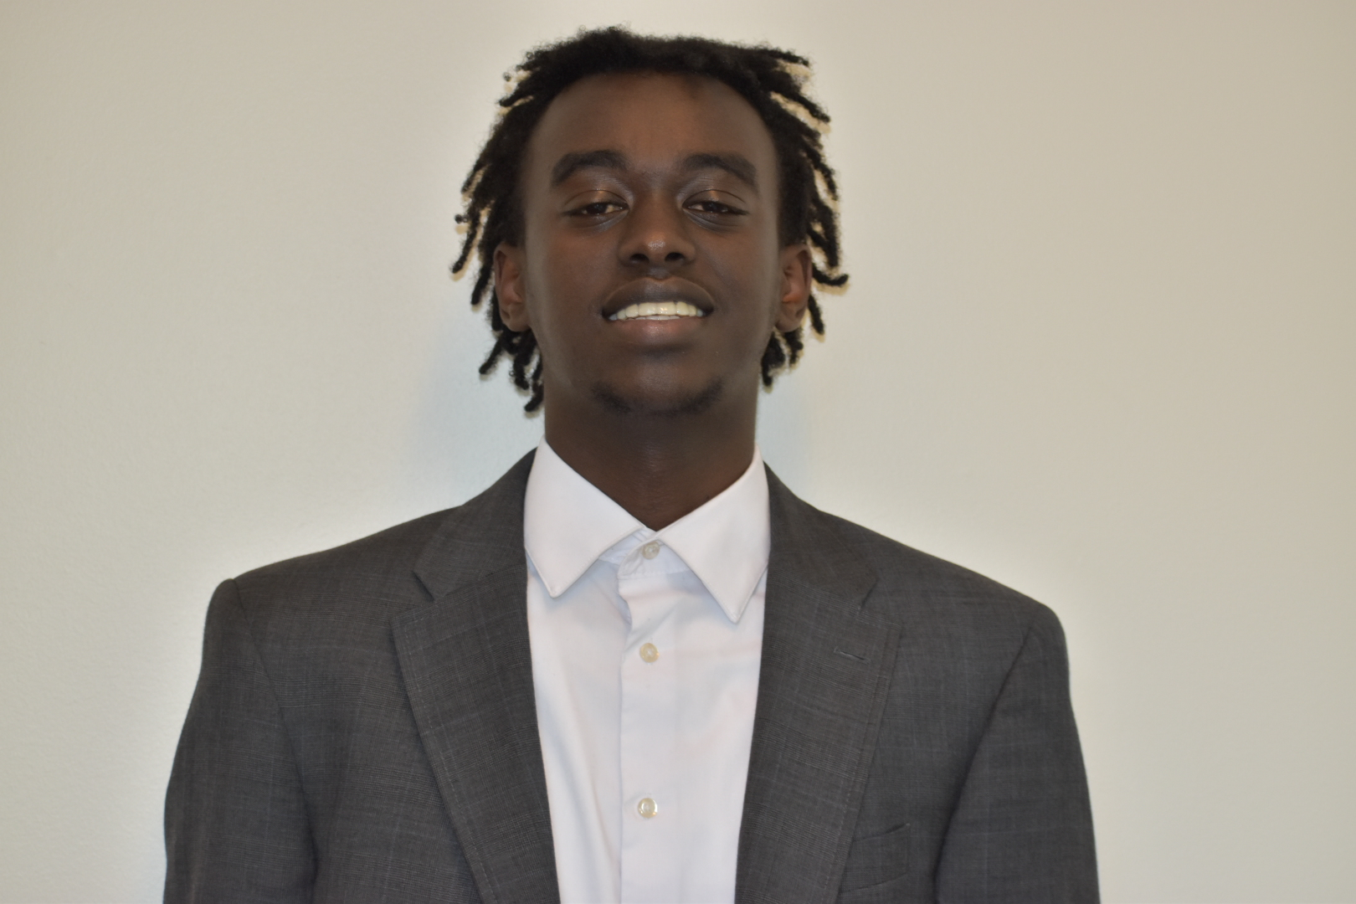
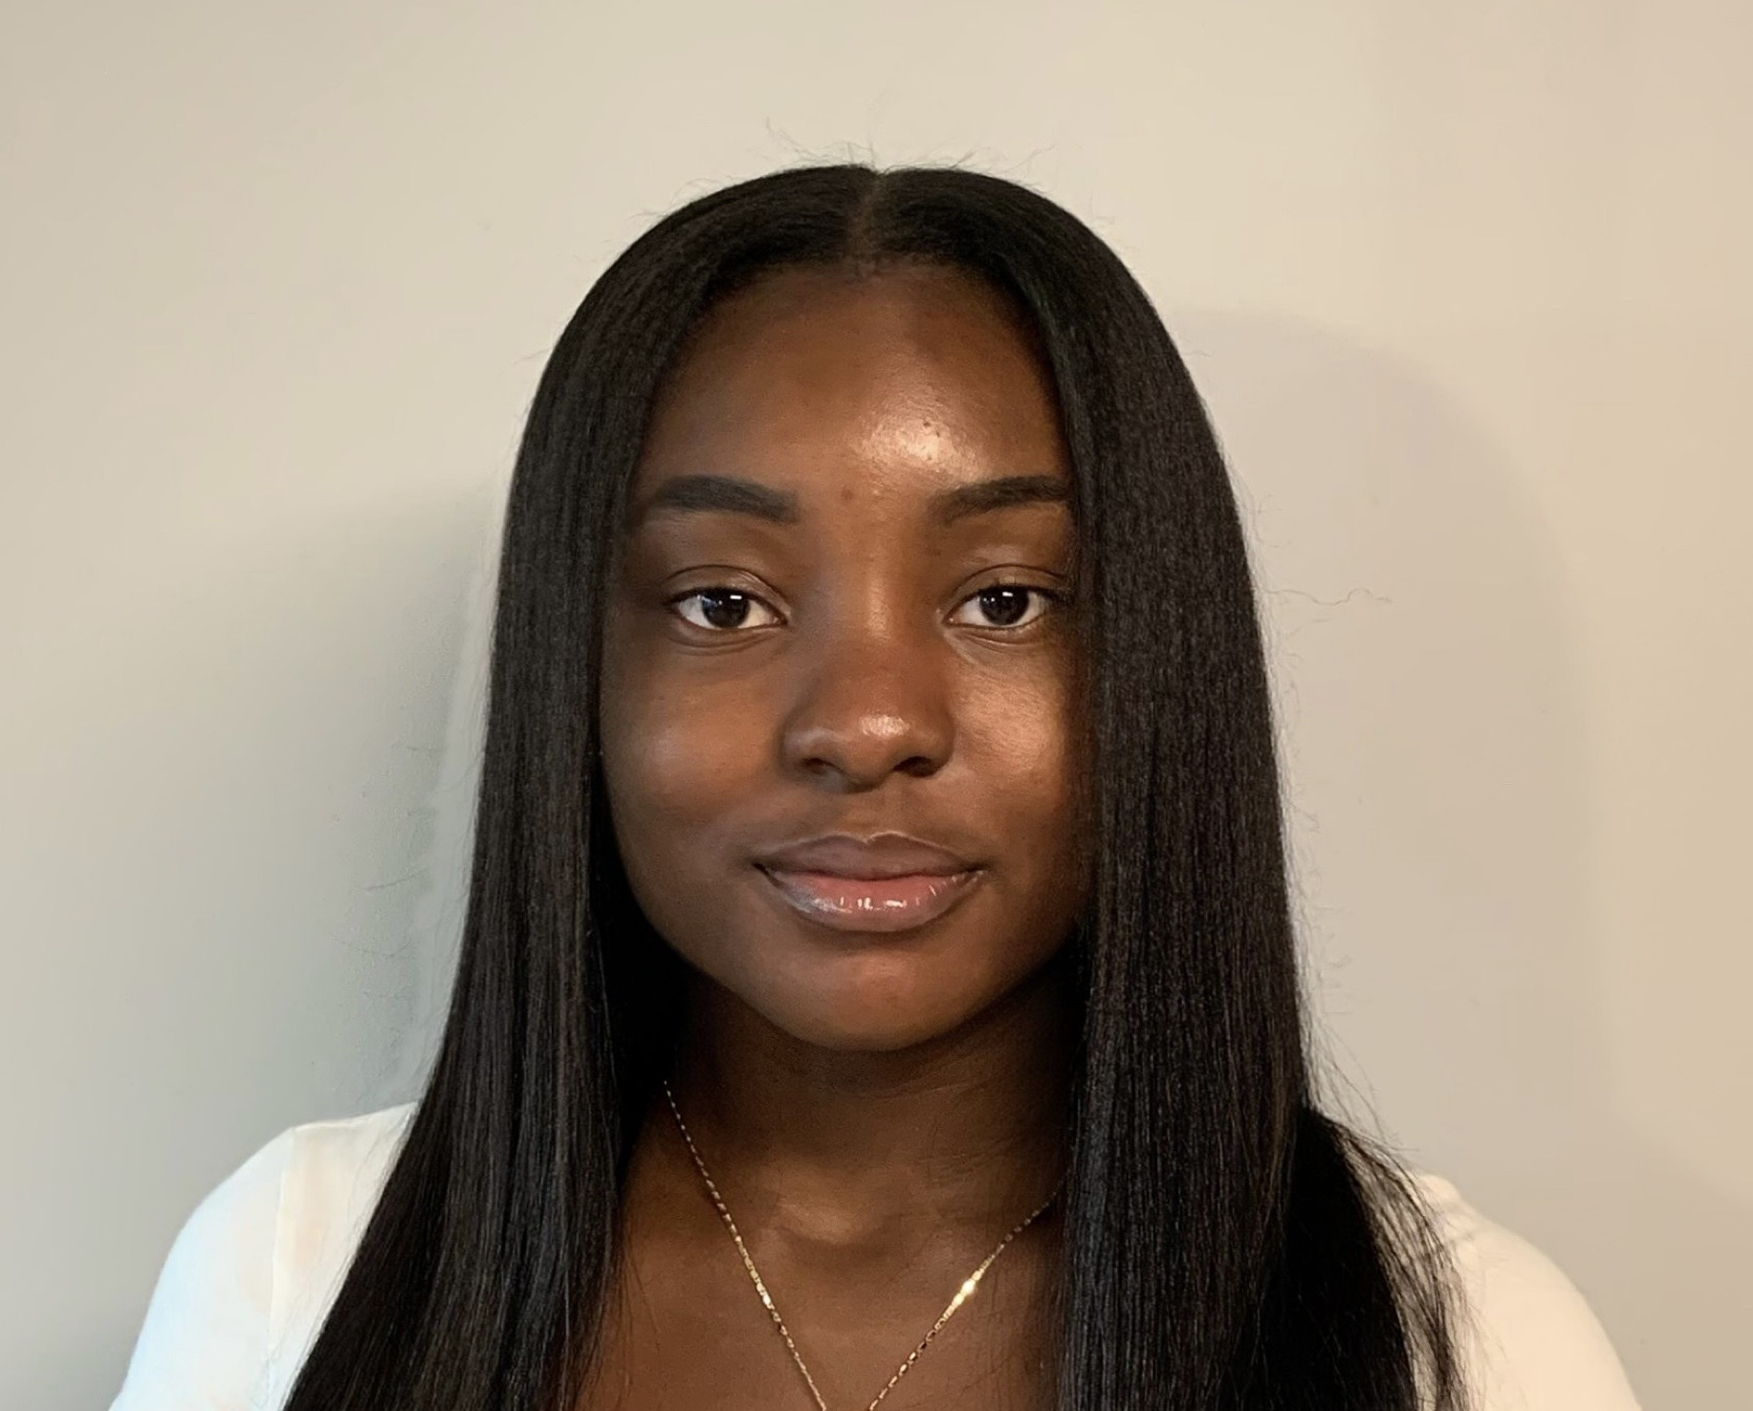


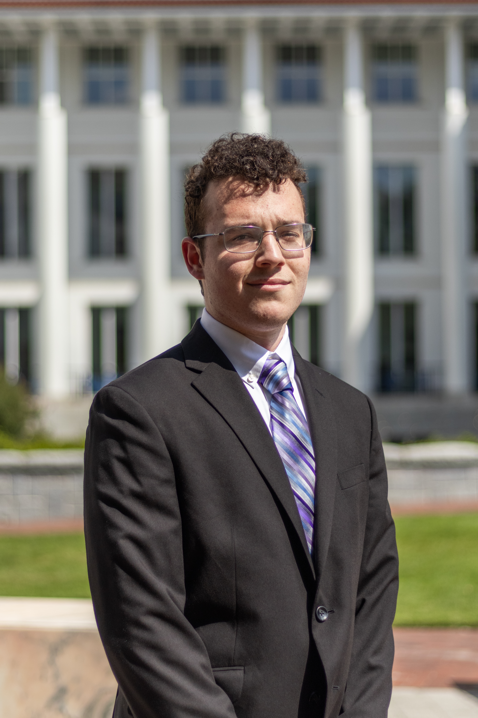
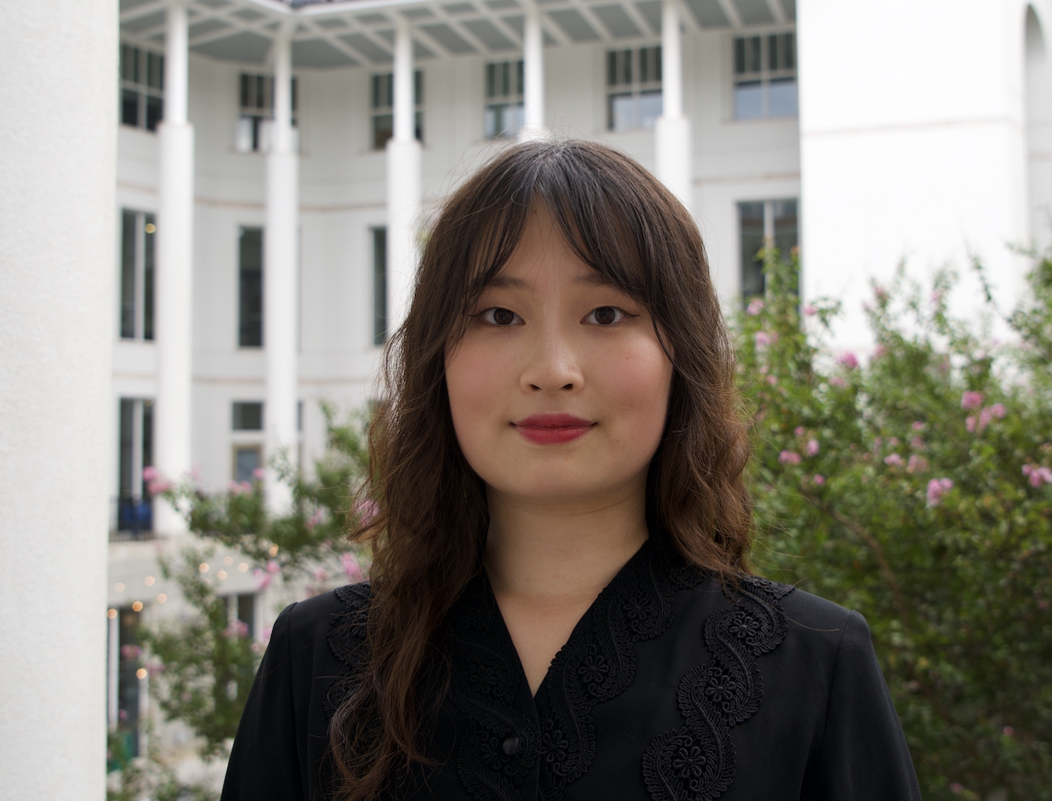


Team

Slide 3
Team
Hamza Alkadir
Kultum Lhabaik
Jessie Ni
Mori Schacter

Slide 4
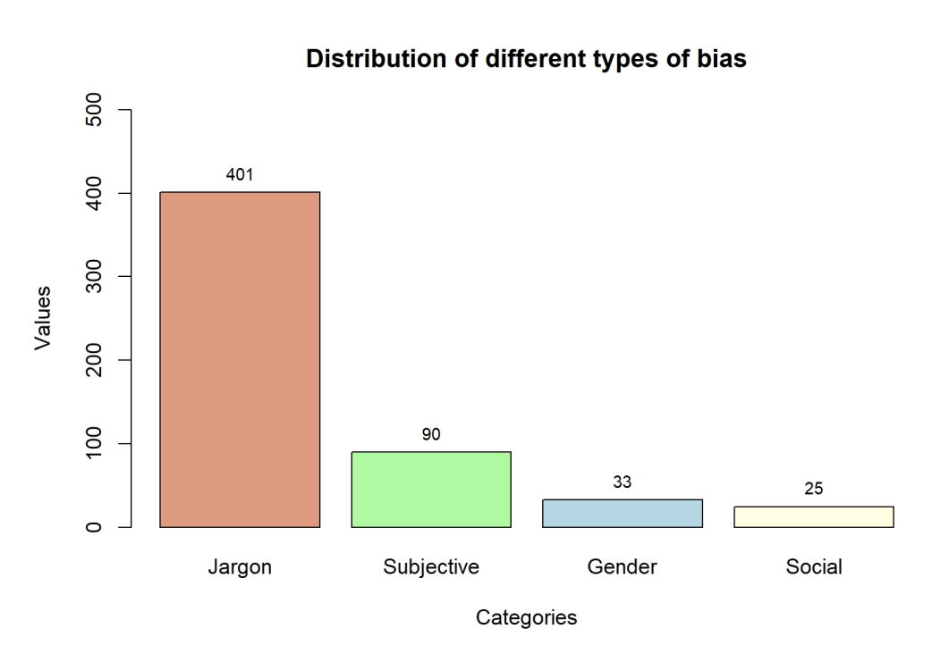
Problem Space
From our previous research on debiasing Michael C. Carlos Museum’s textual descriptions according to our four categories (jargon, subjective, gender, social), we experienced incovenience in manually inspecting text descriptions without cross-verifying images from the museum website.
To address this specific challenge and further automate the debiasing process, we aim to harness the power of mage detection streamline bias detection in the past semester
Notes:
Read!

Slide 5
Project Methodology
Experimented with multiple existing tools including
Microsoft Azure, GPT, IBM Watson, Google Cloud Vision, Clarifai, DALLLE, Adobe Sensei, and others.
Web Scraping
Object ID <--> Artifact Description <-> Media ID <--> Museum Website image
Optimized the image extraction process for efficiency and accuracy.
Deployment / Fine-tuning
Prompt Engineering & Prompt chaining
Uploaded annotated textual training data, bias metrics, instructions, related readings, news, among others
Notes:
We experimented with a variety of tools to explore their potential as a group. Each tool offered unique capabilities, but most of them did not return satisfactory enough results for our purpose. We eventually decided to use the GPT model.
One of the key areas we worked on was web scraping. Specifically, we developed a process to connect Object IDs, Artifact Descriptions, Media IDs, and corresponding Museum Website images into a streamlined pipeline. This helped link textual descriptions and visual content efficiently.
In the deployment or fine-tuning phase, we tried to improve the model by carefully crafting and linking prompts to guide the models; uploading annotated textual training data, bias metrics, instructions, related materials, news, etc. Generally information that will help the model to create a comprehensive foundation for achieving better outcomes.

Slide 6
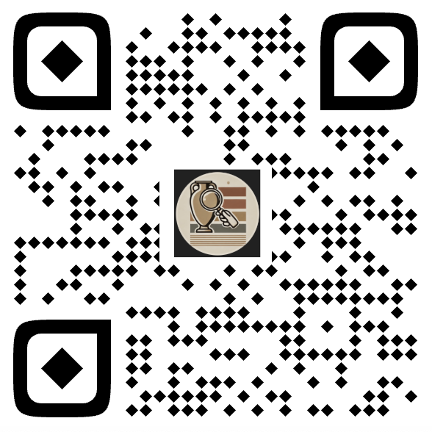
Project Outcome
Discovered limitations in existing tools when processing and analyzing image and text data simultaneously.
Finished a working web scraping code file that is capable of scraping almost all images from the website, including different angles of the same artifact
Implemented a ChatGPT AI Custom Chatbot to enable user-friendly application and leverage advanced image processing capabilities.
Intake image + text description
-> return suggestion according to bias categories
Notes:
Read
+ here is a QR code of our working GPT ChatBox for image detection.
Note that it is currently designed for taking in museum artifact text descriptions and museum photos. The effect might not be as helpful for other types of text entry.

Slide 7
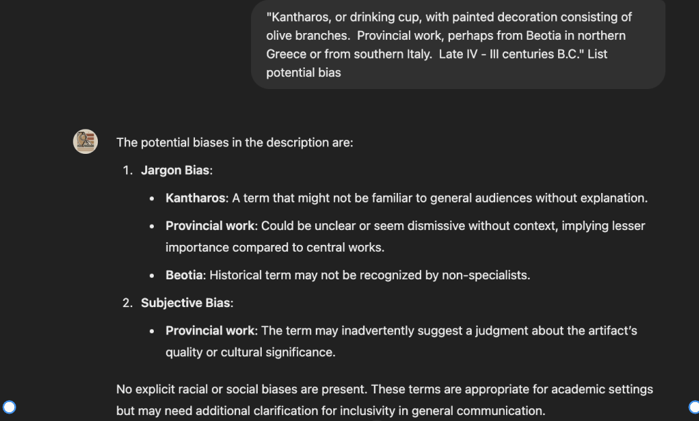
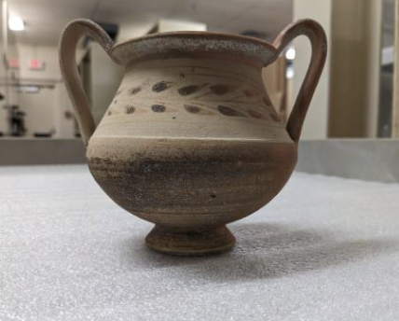
Sample Object 246 Kantharos
Notes:
Here is an example of the result output from the chatbox
When we import a picture of the Kantharos, a drinking cup, this is what the model returns.
Based on manual annotation results, there should be one jargon bias here, which is in the title – kantharos. This would be a word that a lot of people don't know, if there is no text provided immediately after. So we would hope the model labels jargon bias in its output, and it did.

Slide 8
Future Direction
Further fine-tuning efforts include:
Continuously refining the model, as additional fine-tuning generally improves performance.
Collaborating with curators to draft sample responses, enabling the chatbot to better interpret and present image information.
Exploring more flexible models, such as LLAMA or Hugging Face, to enhance adaptability and performance.
Narrowing the scope to a specific time period, genre, or bias type to improve the model's precision and focus.
Notes:
Read or skip, depending on the how much time is left

